Slide 1
SAP BTP Build Apps Training
Day 10
Anubhav Oberoy
www.AnubhavTrainings.com
Follow excellence with sheer passion

Slide 2


DISCLAIMER
The training content and delivery of this presentation is confidential, and cannot be recorded, or copied and distributed to any third party, without the written consent of Anubhav Trainings

Slide 3
Agenda – Day 10
01
Create destination for Build BPA
02
Access Process and consume in Build Apps
Deploy App
03
Integrate with Build workzone

Slide 4


Scenario
process
destination
Build Process Automation
BTP
Sales Order
(Build Apps)
approval
<cartID>
app
rej
Manager
<data>
Sales Representative
Build workzone
My Inbox
Cloud
<<Cart data>>

Slide 5
Destination
https://help.sap.com/docs/build-process-automation/sap-build-process-automation/configure-sap-build-process-automation-destinations

Slide 6





















Slide 7
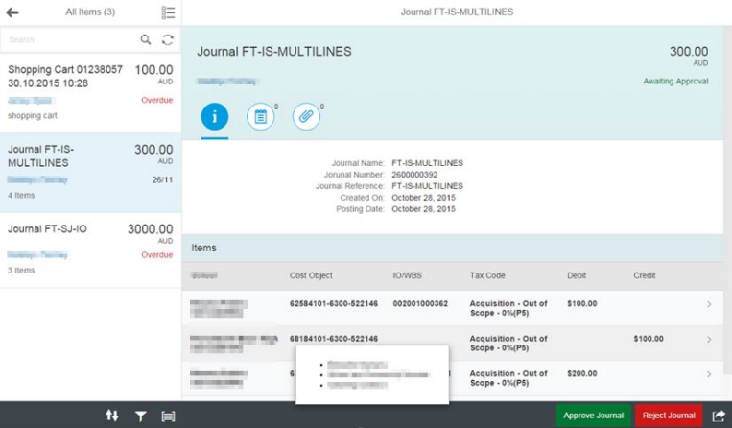
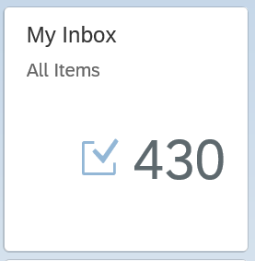
My Inbox Fiori App
In SAP Business Technology Platform (BTP), the Inbox Fiori app typically refers to an application that provides a centralized view for managing tasks and notifications within the system. This app allows users to handle workflow tasks and process approvals directly from within the Fiori interface.
Here are some key points about the Inbox Fiori app:
1. Task Management: It provides an interface where users can view, manage, and act upon their tasks. These tasks can be related to business workflows, approvals, or notifications that need attention.
2. Integration with SAP Workflow: The Inbox app is often integrated with SAP Business Workflow, allowing users to interact with tasks that are part of larger business processes.
3. User-Friendly Interface: As part of the Fiori design principles, the app offers a simple, intuitive, and responsive user interface that can be accessed on desktop and mobile devices.
4. Real-Time Updates: Users are notified of new tasks, and updates to tasks are reflected in real-time, ensuring that users can stay on top of their workload.
6. Access Control: Only users with appropriate roles and permissions can access specific tasks, ensuring that the right people are notified and able to act on the tasks.

Slide 8
Anubhav Trainings – The server
Anubhav trainings offers fully activated S/4HANA system
No VPN is required to access
Personal laptop with direct SAPGUI
All our courses can be practiced in the same server
It have all the APIs and test data required for learning
A developer user will all the permission
SAPGUI installation
Guide, videos & documentation to connect will be provided
SLA 4 H, 9 AM – 6 PM
You can connect to our system w/o cloud connector from SAP Build

Slide 9
The Destination to S/4HANA
The service information is here:
http://stsrvr.mynetgear.com:8021
Property | Value
sap.applicationdevelopment.actions.enabled | true
sap.processautomation.enabled | true
sap.build.usage | odata_gen
AppgyverEnabled | true
WebIDEEnabled | true
HTML5.DynamicDestination | true

Slide 10

What We Did
Let’s Summarize

Slide 11

www.anubhavtrainings.com
Thank You
End of Day 9

Slide 12


We’re committed to empower you to be
#FutureReady
through powerful training solutions.
We build the workforce of the future.
250+
Corporate Clients
30,000+
Learners Trained
25000+
Learners Placed
FREE WEBINARS
Sign up for free webinars with industry experts every fortnight!
Enroll Now!
Contact us today!
https://anubhavtrainings.com

